Slide 1
Nethack Game Icebreaker
Lesson B.1

Slide 2
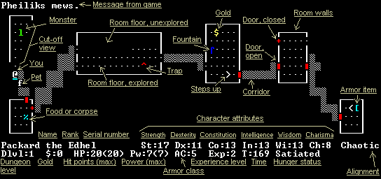
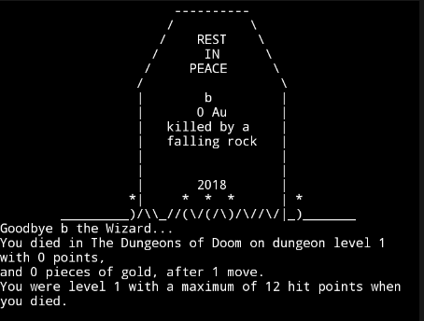
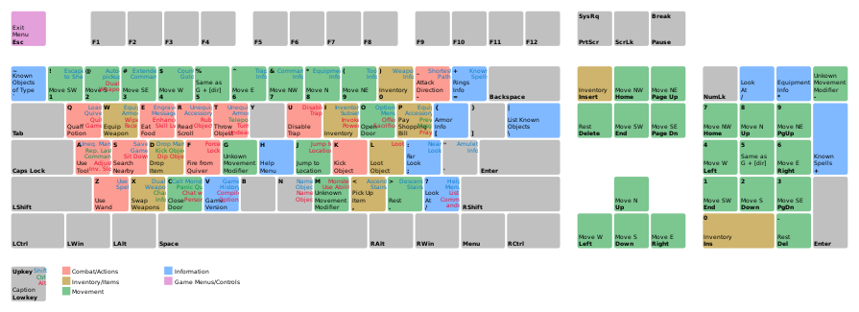
What Is Nethack?
Nethack was released in 1987
Uses ASCII Graphics (before VGA)
Runs on early PCs and mini-computers
Was based on Rogue (1980) and Hack (1982)
These were the first Turn Based RPG games
Are the basis for all current RPG (Roll Playing)
Lead to the development of RTS (Real-Time Strategy) and FPS (First Person Shoter) games
Introduced the concept of an "inventory", etc.

Slide 3
Nethack Interface

Slide 4
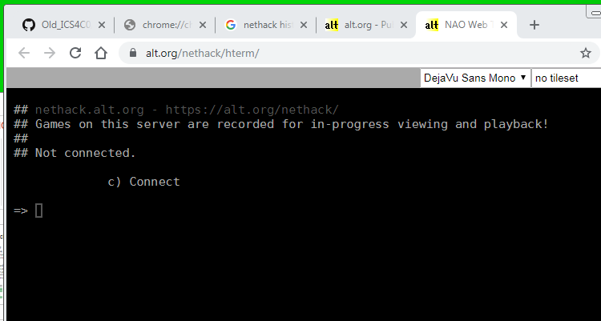
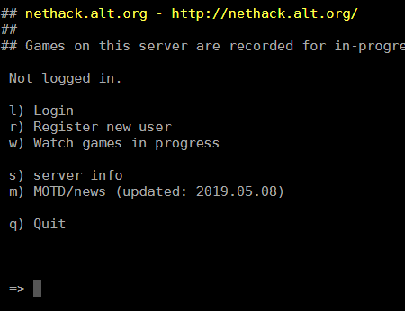
Resources
Nethack Online
https://alt.org/nethack/
Nethack Guidebook
Nethack Open Source
https://github.com/NetHack/NetHack

Slide 5
Debrief – Level 1
How many levels have you done? (How many times did you die?)
What have you found out so far…
Monsters
Special Items
Useful Commands

Slide 6
Debrief – Level 1 (Cont’d)
Does the primitive display limit the game?
How is the game more complex or less complex than modern games?

